Slide 1


The Effect of Diabetes and Biological Markers on Blood Pressure Readings through both a Predictive and Traditional Statistical Lens
Team #6
Ente Kang
Jingwen Ji
CHL5230- APPLIED MACHINE LEARNING FOR HEALTH DATA
Fall 2023
University of Toronto
Notes:
- Do not alter the font size and color of the text components.
- Add your team number and the names of your team members to the assigned text box without making changes to the font and formatting.
- Please do not add extra details to the cover page.
- Ensure that the entire presentation does not exceed 90 seconds.
- Suggestion: Allocate 10 seconds to this slide.

Slide 2

What are affecting Blood Pressure readings?
Predicting hypertension using diabetes status
Modelling the effect of diabetes and biological markers on repeated systolic blood pressure (sBP) readings
People with diabetes are twice as likely to have high blood pressure (Johns Hopkins Medicine), and systolic blood pressure is the best way to predict future cardiovascular events and death (American Heart Association)
Diabetes dataset (Dr. Keshavjee). 10,000 observations with 8,602 unique patients. Range from 1-8 repeated measurements. Hypertension status did not change for a patient, but their sBP readings do!
Notes:
- Maintain the existing slide template.
- Recommended duration: 20 seconds.

Slide 3
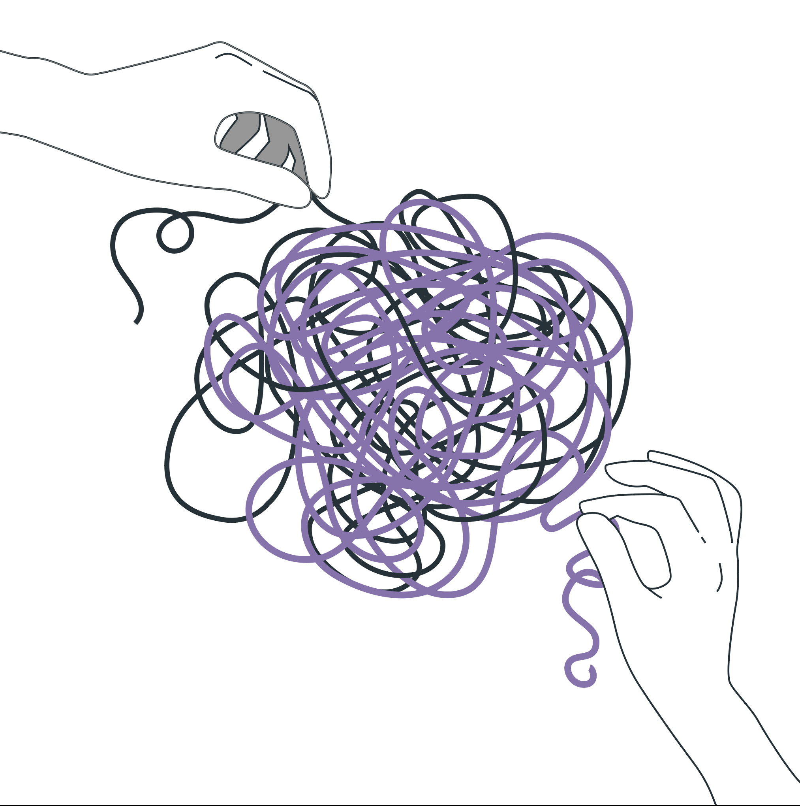
Methodology (Inside the Box)
Logistic Regression and Linear Mixed Effects Models (LMM)
Justification: understanding the effects of our predictors, and modelling repeated measurements
Keeping clinically important variables
Hypertension (binary), and systolic blood pressure (continuous, repeated)
Novelty: modelling and predicting repeated measurements, while understanding the contributions of our predictors
Notes:
- Provide an overview of the Methods section in this slide, including the ML models employed and the rationale for their selection.
- Maintain the slide's title and template as provided.
- Suggestion: Allocate 20 seconds to this slide.

Slide 4
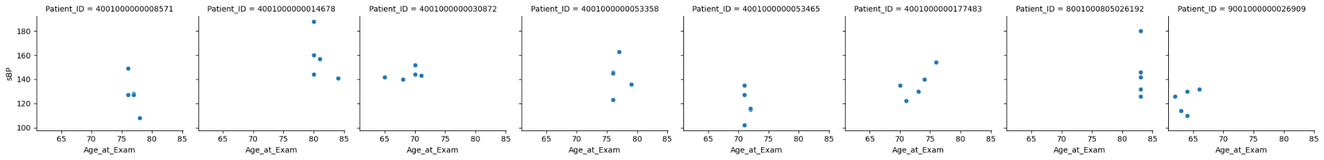
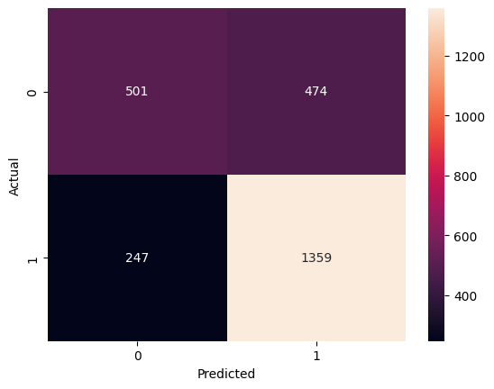
Results
Prediction of Hypertension (Logistic Regression): Recall = 85%
Prediction of sBP (through LMMs): MSE = 280.9
Thoughts on performance…
Overfitting and generalizability
Figure 2: sBP vs Age
Figure 1: Confusion Matrix
Notes:
- Summarize the primary outcomes of your work.
- Present the content with a technical focus, yet in a way that is easily understood by non-technical attendees.
- Suggestion: Dedicate 20-25 seconds to this slide.

Slide 5
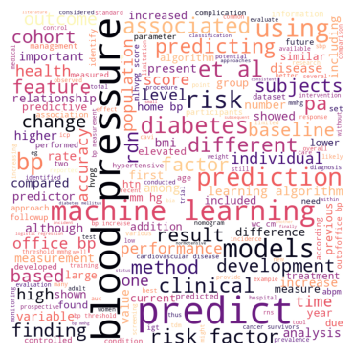
The Bridge between Diabetes, Age, and Blood Pressure
Patients with diabetes had 1.6 times the odds of having hypertension than those without diabetes (Logistic Reg.)
A one year increase in age at examination was associated with 0.25 increase in sBP (LMM)
More flexible methods or incorporating random effects may provide better prediction results
Diversity and equity
Figure 3: Diversity, equity and equality in ML research
Notes:
- Please do not change the text formatting.
- Choose a concise and informative title for this slide, as it serves as the conclusion of your presentation.
- Suggestion: Allocate 15-20 seconds for this slide.

